Slide 1


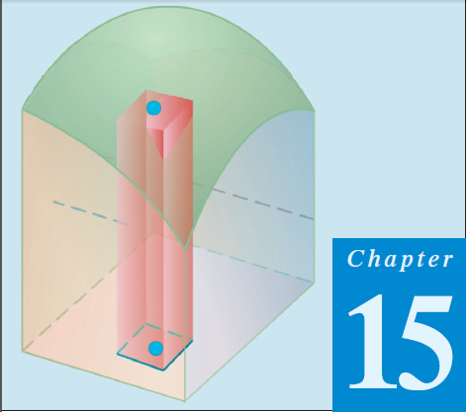
Thomas Calculus 11th
09
Double Integrals non Rectangular Regions
Samuel Lukas

Slide 2
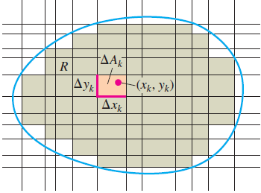

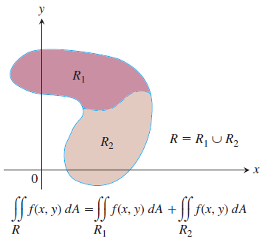
Double Integrals over Nonrectangular Regions

Slide 3
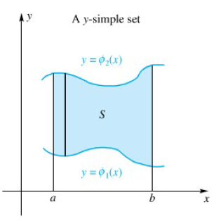

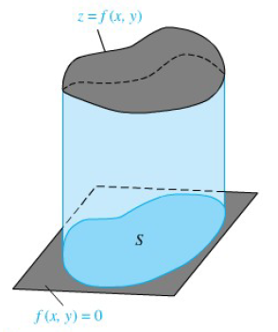
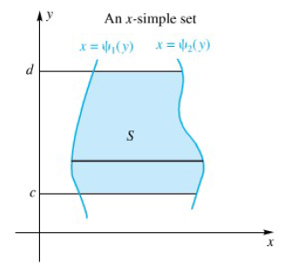

Determining The Integral

Slide 4
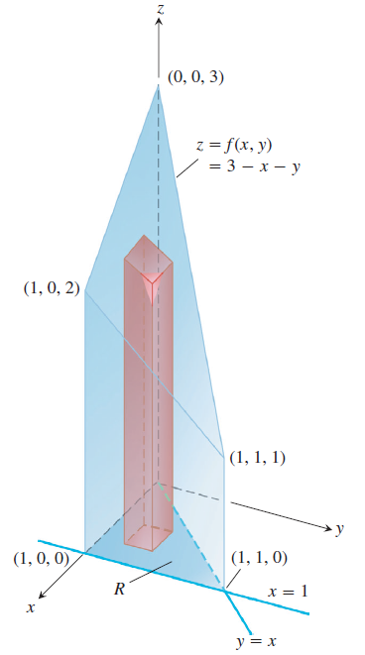
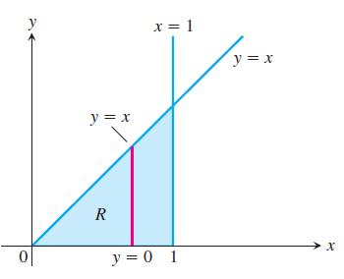

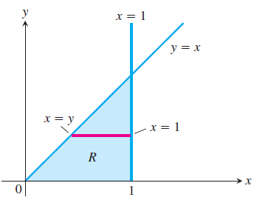

Example 1

Slide 5

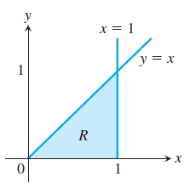
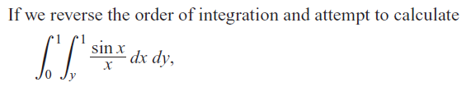

Example 2

Slide 6


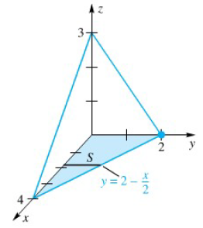




Example 3
Find the volume of the tetrahedron bounded by the coordinate planes and the plane 3x + 6y + 4z – 12 =0

Slide 7

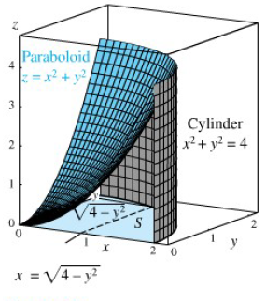
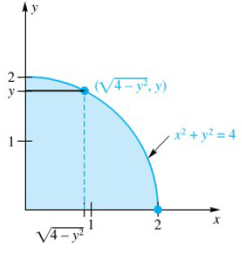








Slide 8

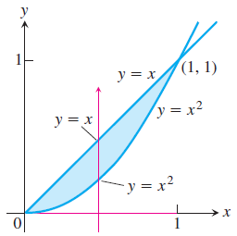




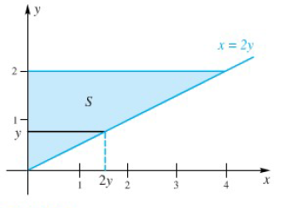
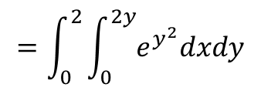
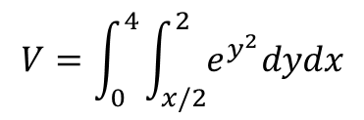
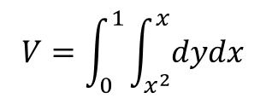

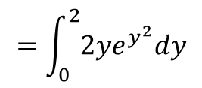
$$V=\int_{0}^{1}{\int_{x^{2}}^{x}{dydx}}$$
$$V=\int_{0}^{4}{\int_{x/2}^{2}{e^{y^{2}}dydx}}$$
$$=\int_{0}^{2}{\int_{0}^{2y}{e^{y^{2}}dxdy}}$$
$$=\int_{0}^{2}{{2ye}^{y^{2}}dy}$$
$$=e^{4}−1$$

Slide 9





Exercises
1.
2.
3.
4.
5.
6.
7.

